Slide 1

Spam Message Classification Using Machine Learning
by
M.Sireesha
Roll No. 184G1A0589
R.S.Santhoshi
Roll No. 184G1A0584
K.Tejdeep Reddy
Roll No. 194G5A0509
Under the guidance of
Mr. Lingam Suman _{M.Tech.,( Ph.D)}
Assistant Professor
Department of Computer Science and Engineering
Srinivasa Ramanujan Institute of Technology
(Affiliated to JNTUA & Approved by AICTE) (Accredited by NAAC with ‘A’ Grade & Accredited by NBA (EEE, ECE & CSE)
Rotarypuram Village, B K Samudram Mandal, Ananthapuramu – 515701.
2021 - 2022

Slide 2
Abstract
Now-a-days all the communication can be done by digitally. Digital tools allow two or more persons to coordinate with each other. This communication can be textual, visual, audio and written. Smart devices including cell phones are the major sources of communication these days.
Unwanted information define as junk data that we received in gadgets. Most of the companies promote their products or services by sending spam texts ,spam mails which are not welcomed. In general, most of the spam emails are more in number than actual messages. Due to this our data can be steal or hacked by the spammers for their satisfaction and some for earning money.

Slide 3
Contents
Introduction
Existing System
Proposed System
Literature survey
Problem Definition
Planning of the project
Requirements
Architecture
UML diagrams
Data flow diagram
Implementation
Screenshots
Conclusion
References

Slide 4
Introduction
Spam: Spam as any kind of unwanted, unsolicited digital communication that gets sent out in bulk. Often spam is sent via email, but it can also be distributed via text messages, phone calls, or social media.
Spam email also known as widely junk mail which is a set of emails that involves same content and usually contain links and malwares which leads to the mis usage of data.
Types of Spam :
Phishing
Email spoofing
Comment spam
Spiders , Bots and DDoS Attacks

Slide 5
Contd…
Spam Messages are messages which are sent to a large group of recipients without their confirmation. Now-a-days these spam messages have increased sharply for gaining the information from the unknown users.
Spammers sent the URLs offering cashback which may attract the users for clicking that url in this way the users important data can lead to the mis usage.
Some spammers do this type of illegal activity for earning the money and some other passes the information of one company to other company which decreases the company’s reputation.
A spam message classification is a step towards building a tool for message identification and early detection.
Types of words that related to spam are: Lottery, win cash back, big sale offer etc.

Slide 6
Existing System
In the earlier days, by using certain methods like K-NN, Decision tree, results in the less accuracy rate and efficiency in Classification point of view.
K-NN is usually slower for large amounts of data ,because of the calculations required in each new data.
To resolve the problem we are using Naive Bayes classifier and SVM for spam message classification and compare their accuracy rates.

Slide 7
Proposed System
Naive Bayes is the best classifier for classifying of spam messages, because it is applicable to large data.
It is a linear classifier which provides accuracy in the results.
It is more suitable for solving multi-class prediction problems.
It must requires training data for process and gives the fast accuracy rate when compared to other.
SVM is also a classifier which gives the results based on the Hyperplane usage.
Hyperplane contains 2 dotted lines which represents positive and negative hyperplane and 1 solid line represents margin.

Slide 8
Literature survey
[1] Tiago, Almeida, José María GómezAkebo Yamakami. Contributions to the Study of SMS Spam Filtering. University of Campinas, Sao Paulo, Brazil.
The growth of mobile phone users has lead to a dramatic increasing of SMS spam messages. In practice, fighting mobile phone spam is difficult by several factors, including the lower rate of SMS that has allowed many users and service providers to ignore the issue, and the limited availability of mobile phone spam-filtering software. On the other hand, in academic settings, a major handicap is the scarcity of public SMS spam datasets, that are sorely needed for validation and comparison of different classifiers. Moreover, as SMS messages are fairly short, content-based spam filters may have their performance degraded. In this paper, we offer a new real, public and non-encoded SMS spam collection that is the largest one as far as we know. Moreover, we compare the performance achieved by several established machine learning methods. The results indicate that Support Vector Machine outperforms other evaluated classifiers and, hence, it can be used as a good baseline for further comparison.

Slide 9
Contd…
[2] Inwhee Joe and Hyetaek Shim, "An SMS Spam Filtering System Using Support Vector Machine," Division of Computer Science and Engineering, Hanyang University, Seoul, 133-791 South Korea.
This paper describes a powerful and adaptive spam filtering system for SMS (Short Messaging Service) that uses SVM (Support Vector Machine) and a vocabulary.
The system isolates words from sample data using a pre-processing device and integrates meanings of isolated words using a thesaurus, generates features of integrated words through chi-square statistics, and studies these features. The system is realized in a Windows environment and its performance is experimentally confirmed.

Slide 10
Contd…
[3] B. G. Becker. Visualizing Decision Table Classifiers. Pages 102- 105, IEEE (1998).
Decision tables , like decision trees or neural nets, are classification models used for prediction. They are induced by machine learning algorithms. A decision table consists of a hierarchical table in which each entry in a higher level table gets broken down by the values of a pair of additional attributes to form another table. The structure is similar to dimensional stacking . Presented here is a visualization method that allows a model based on many attributes to be understood even by those unfamiliar with machine learning. Various forms of interaction are used to make this visualization more useful than other static designs.

Slide 11
Problem Definition
Unwanted messages which are coming to the users mobile phones in the way of links, mails and SMS irritating the internet connection through this important mails may be missed or delayed. Spam can crash the servers and fill up the hard drives with unknown information which can affect our system. Due to this our systems data will theft easily and sometimes it may erased totally from our system. It can easily attracts the user through mails mostly for losing of their data.

Slide 12
Planning of the project
WEEKS | TASK
WEEK1 | Downloading and installing required softwares
WEEK2 | Data cleaning and preparation on dataset
WEEK3 | Develop a model
WEEK4 | Test the model
WEEK5 | Develop a webpage for our model

Slide 13
Requirements:
SYSTEM SPECIFICATIONS:
H/W Specifications:
Processor :i3/Intel Processor
RAM :8GB(min)
Hard Disk :128GB
S/W Specifications:
Operating System :Windows 10
Server side script :python 3.10
IDE :PyCharm
Libraries Used :Pandas , Numpy, Ntlk, Sk-learn.

Slide 14
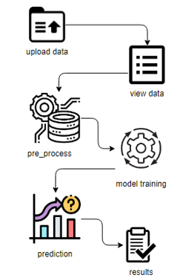
Architecture

Slide 15
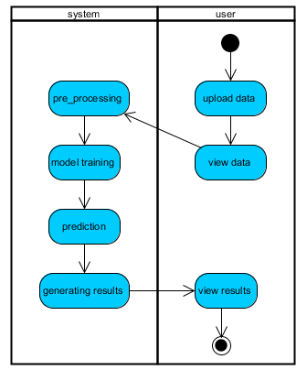
UML Activity Diagram
Start
Flow of data
Activity
Stop

Slide 16
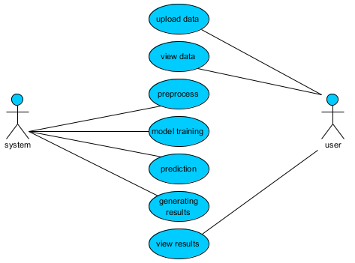
Use Case Diagram

Slide 17
Implementation
After the pre-processing step , we apply the feature selection algorithm, the algorithm which deploy here is Best First Feature Selection Algorithm.
Steps:
Handle Data: Load the file and split it into training and test datasets.
Summarize Data : Summarizes the properties in the training dataset so that we can calculate and make predictions.
Make a Prediction : Use the summaries of the dataset to generate a single prediction.
SVM:SVM are a set of supervised learning methods used for classification and outliers detection. In SVM, each data item will be plot in n-dimensional space with the value of each feature being value of a particular coordinate. The classification is done by using a hyper-plane that differentiate into 2 classes.

Slide 18
Sample Code
Reading data from dataset
# Load the Pandas libraries with alias 'pd'
import pandas as pd
Read data from file 'filename.csv'
# (in the same directory that your python process is based)
# Control delimiters, rows, column
names with read_csv
data = pd.read_csv("filename.csv")
# Preview the first 5 lines of the loaded data
data.head()

Slide 19
Contd…
Import pandas as pd
import numpy as np
import re
impot nltk
nltk.download(‘stopwords’)
nltk.download(‘punkt’)
from nltk.corpus import stopwords
from nltk.stem.porter import Porter Stemmer
from sklearn.feature_extraction.text import
CountVectorizer
from sklearn.model_selection import train_test_split
from sklearn.naive_bayes import MultinomialNB
from sklearn.svm import LinearSVC
from flask import Flask,render_template,request

Slide 20
Contd…
Scikit-learn(sklearn) is the most useful and robust library for machine learning in python. It provides a selection of efficient tools for machine learning and statistical modeling including classification, regression, clustering and dimensionality reduction via a consistence interface in python.

Slide 21

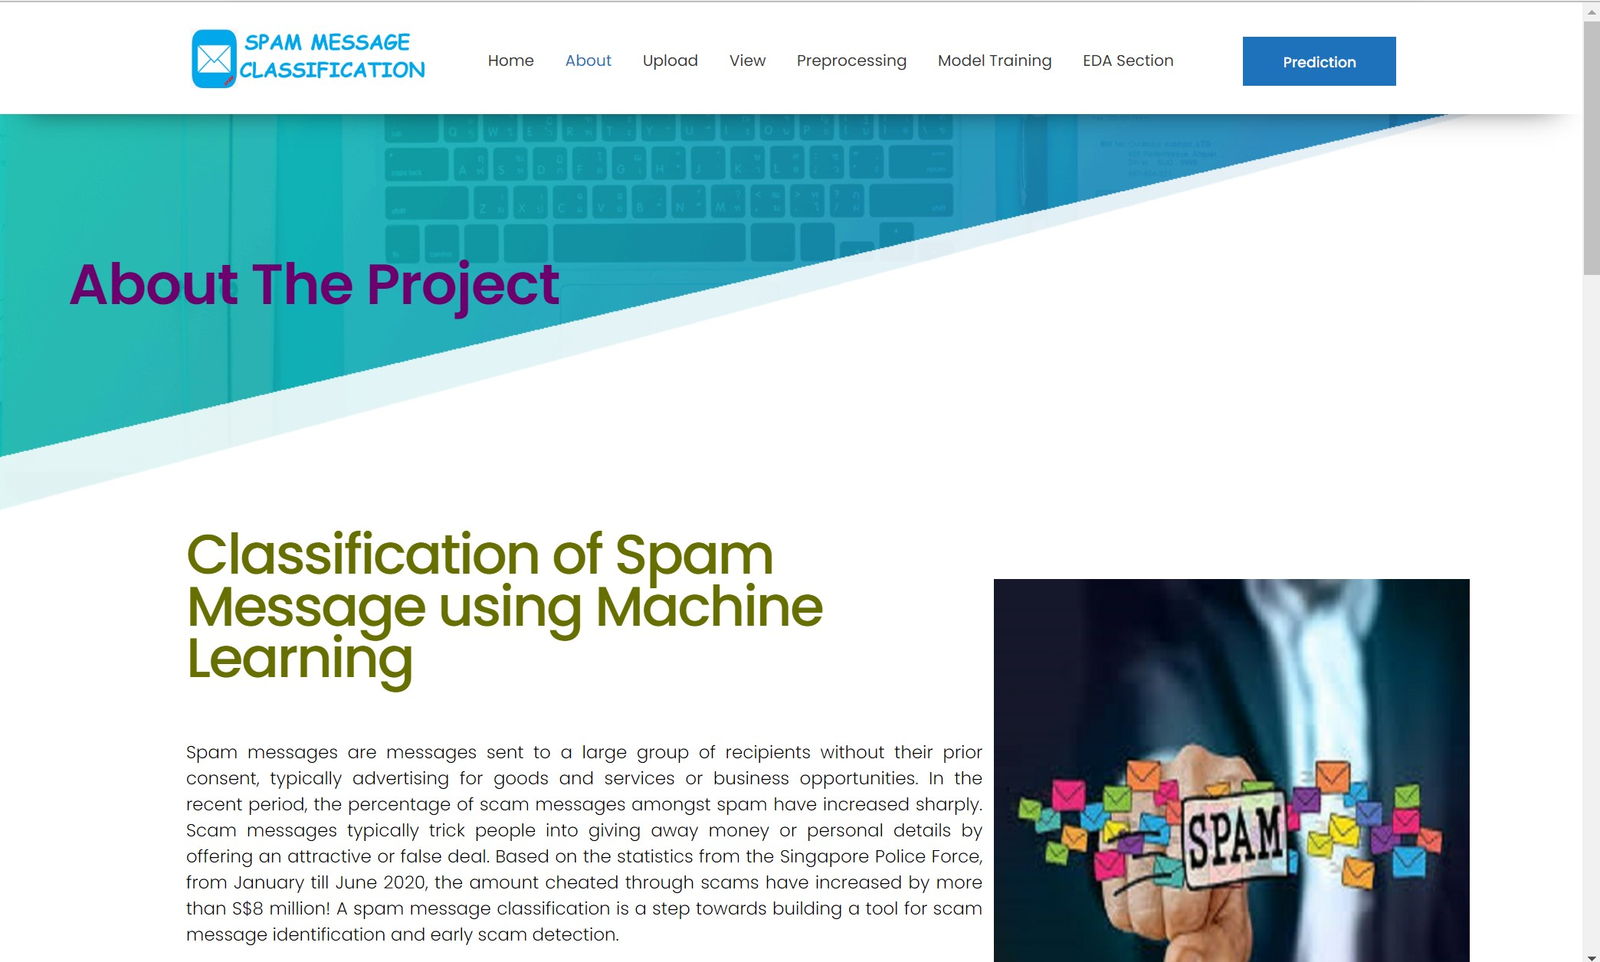
Screenshots
@webapp.route(‘/’)
def index():
return render_template(‘index.html’)
@webapp.route(‘/about’)
def about():
return render_template(‘about.html’)

Slide 22
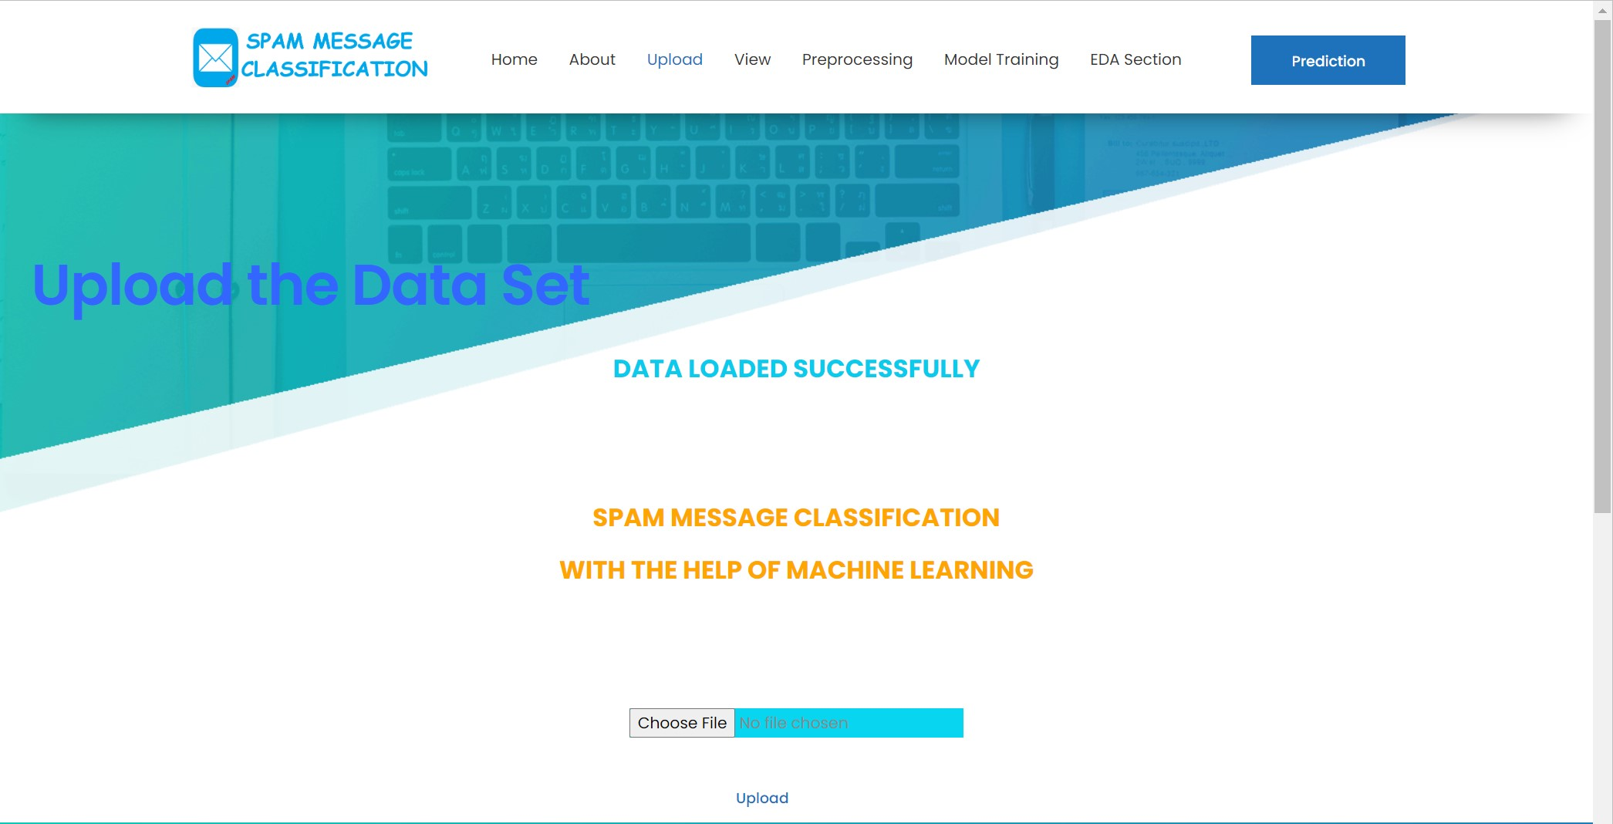
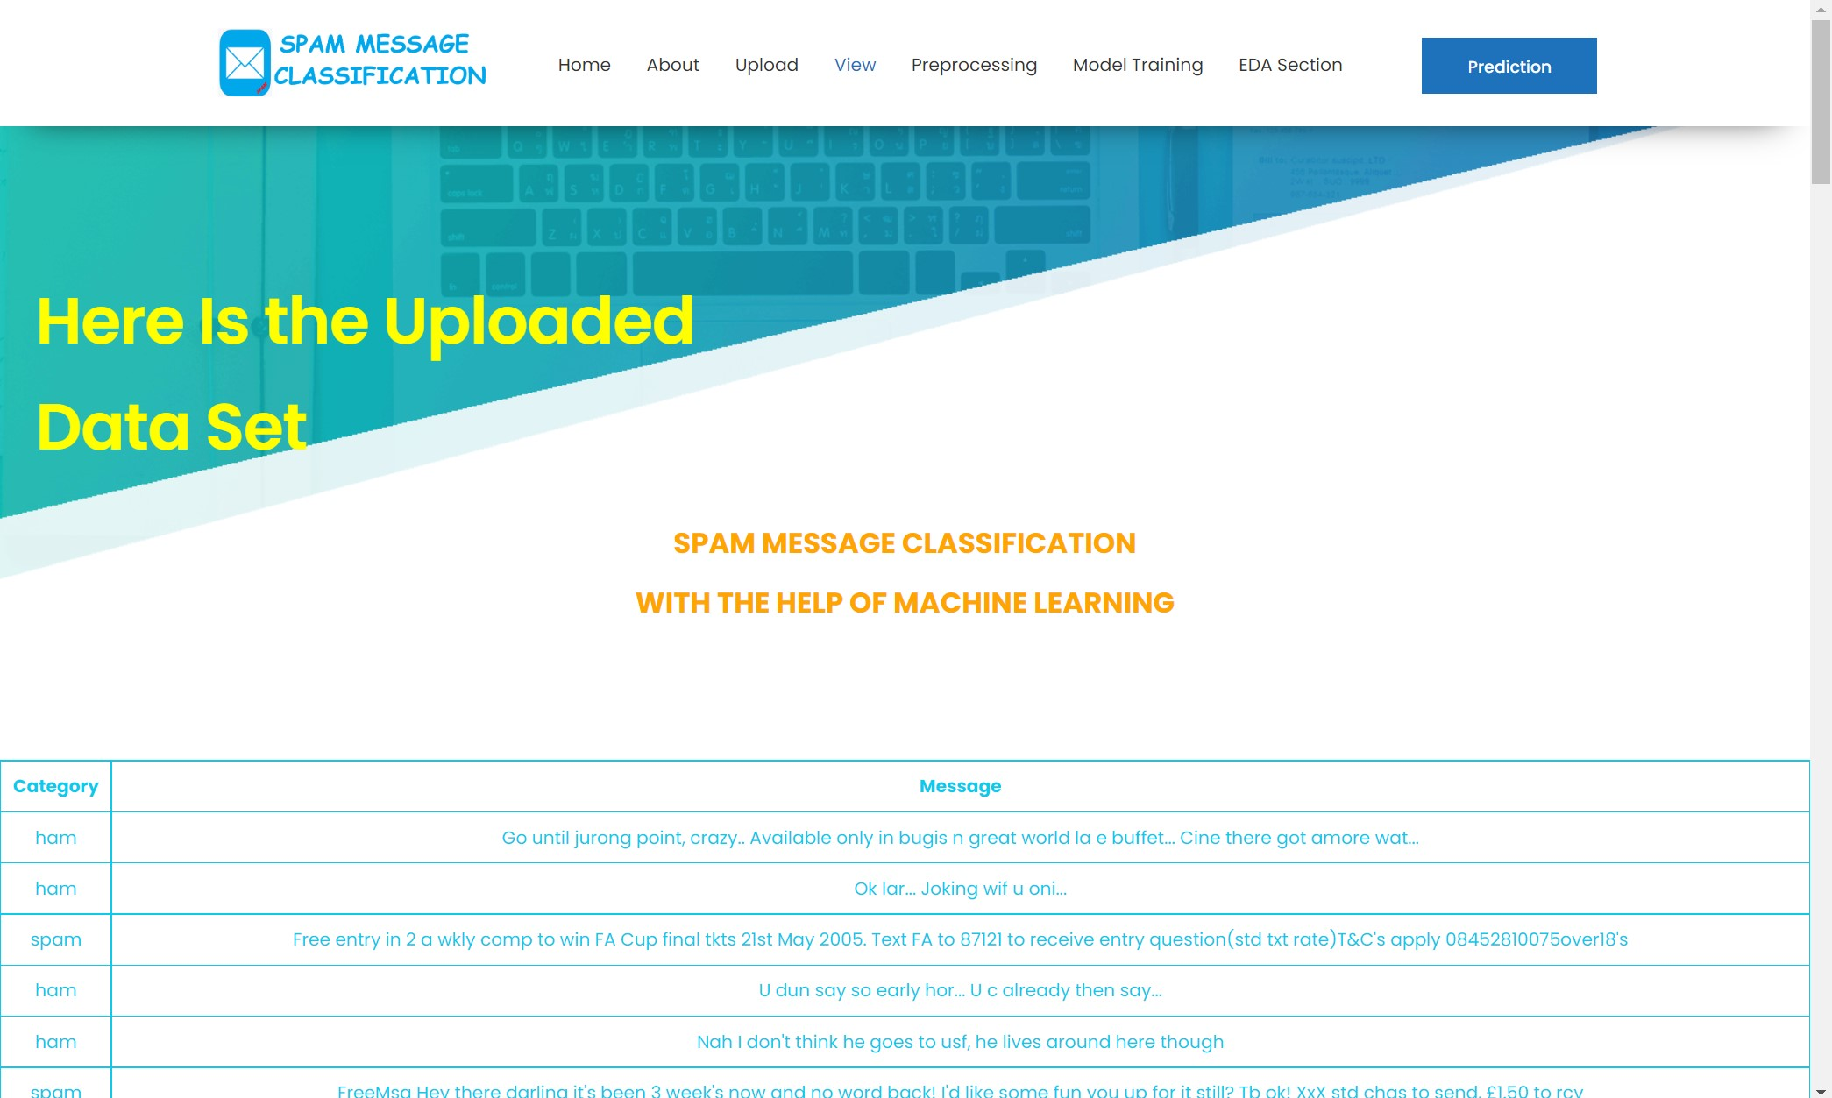
Contd…
@webapp.route(‘/load’,methods=[“GET”,”POST”])
def load():
return render_template(‘load.html’,msg=msg)
@webapp.route('/view’)
def view():
returnrender_template('view.html’,
columns=dataset.columns.values,
rows=dataset.values.tolist())

Slide 23
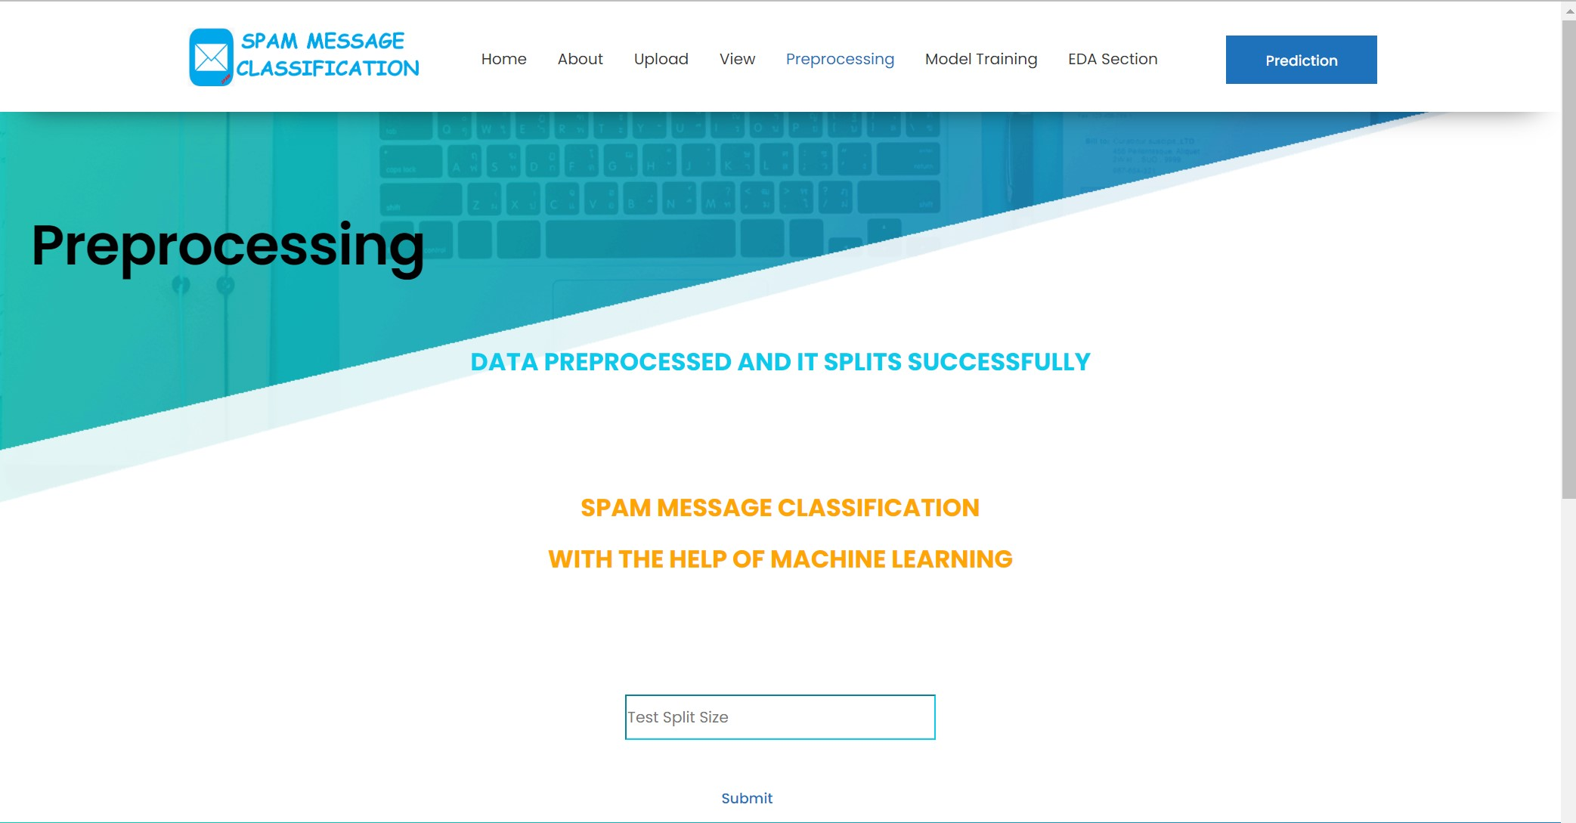
Contd…
@webapp.route('/preprocess', methods=['POST', 'GET’])
def preprocess():
global x, y, x_train, x_test, y_train, y_test, countvectorizer if request.method == "POST":

Slide 24
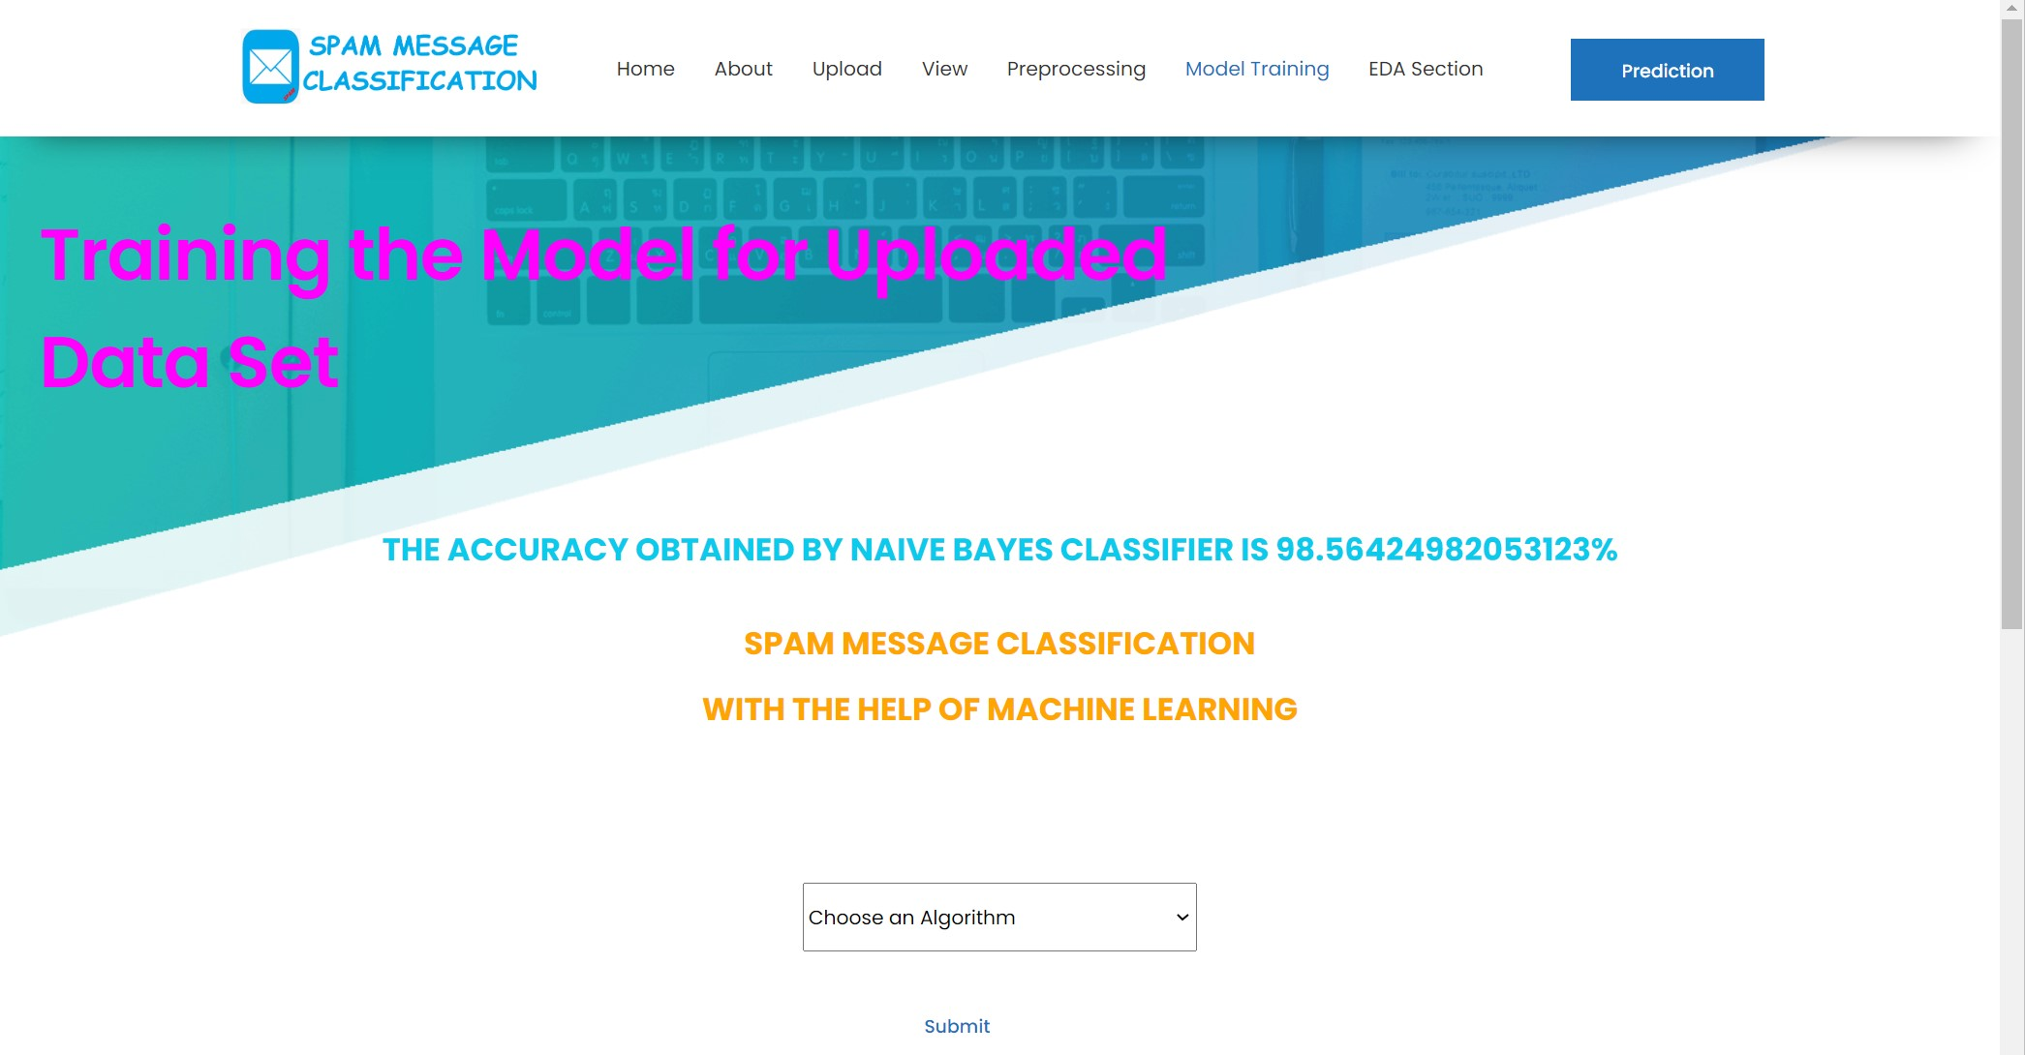
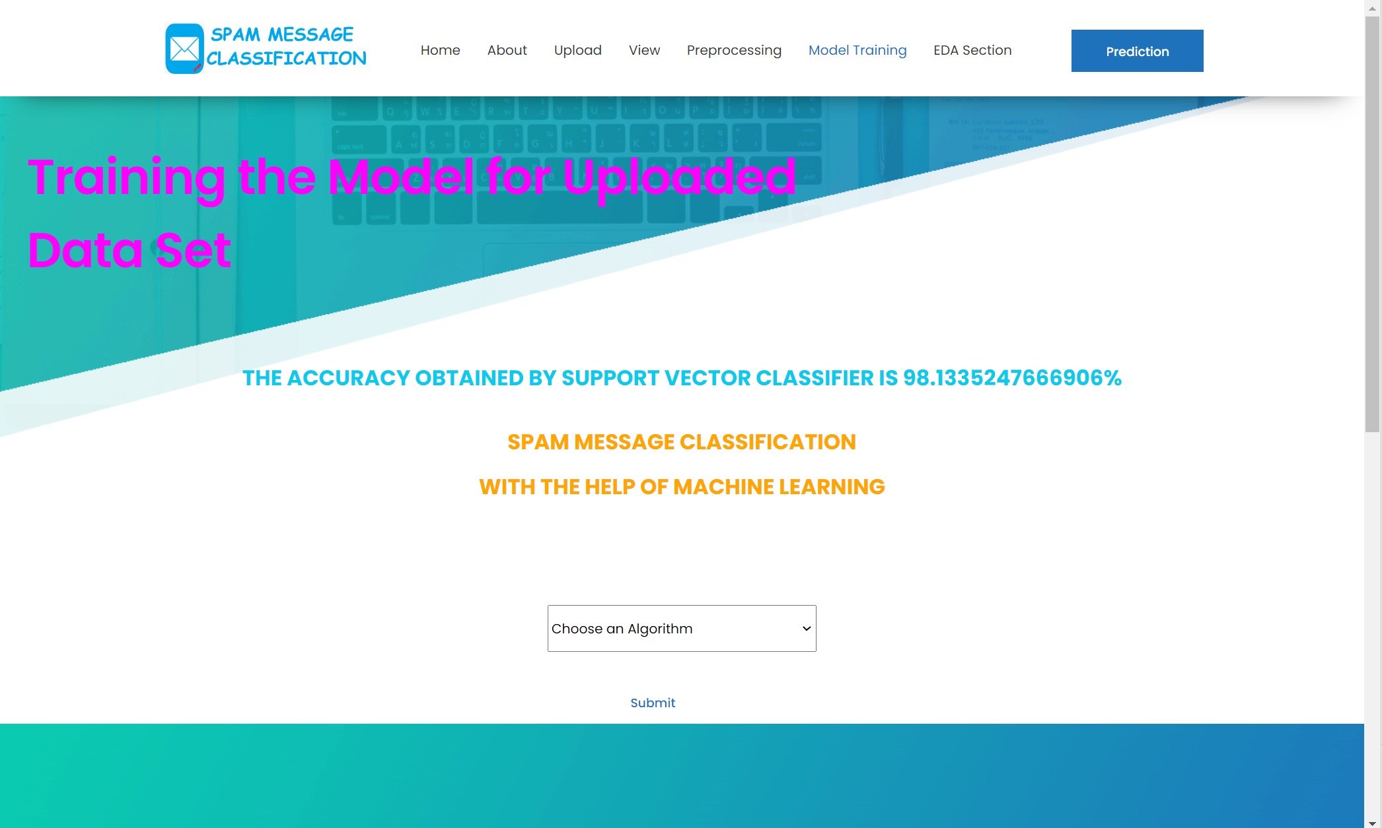
Contd…
@webapp.route('/model',methods=['POST','GET’])
def model():

Slide 25
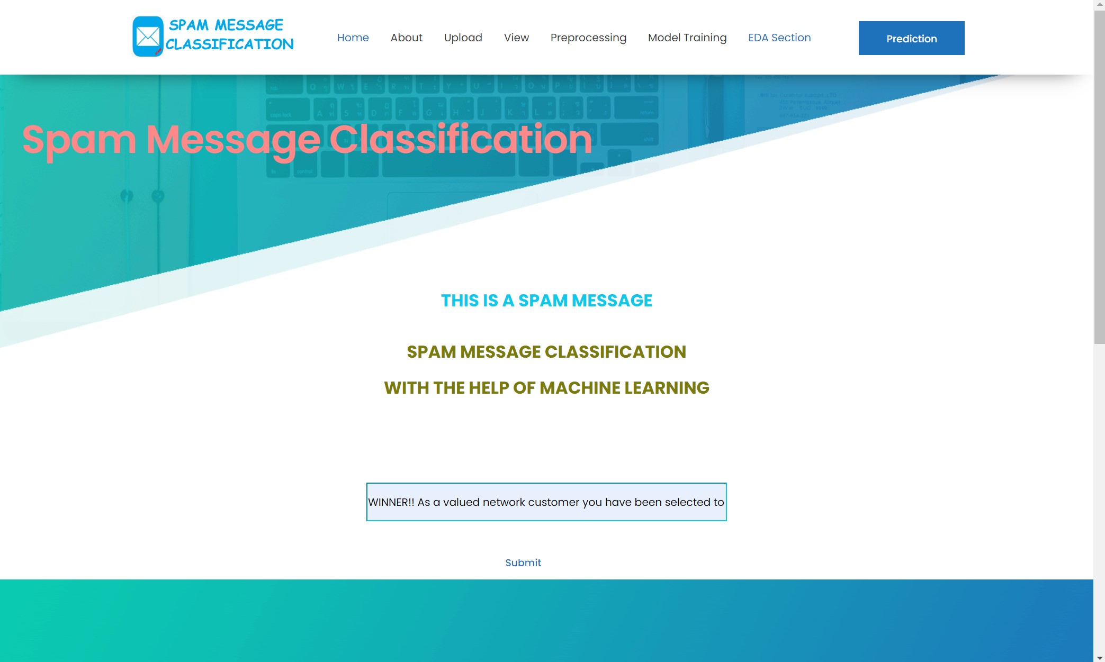
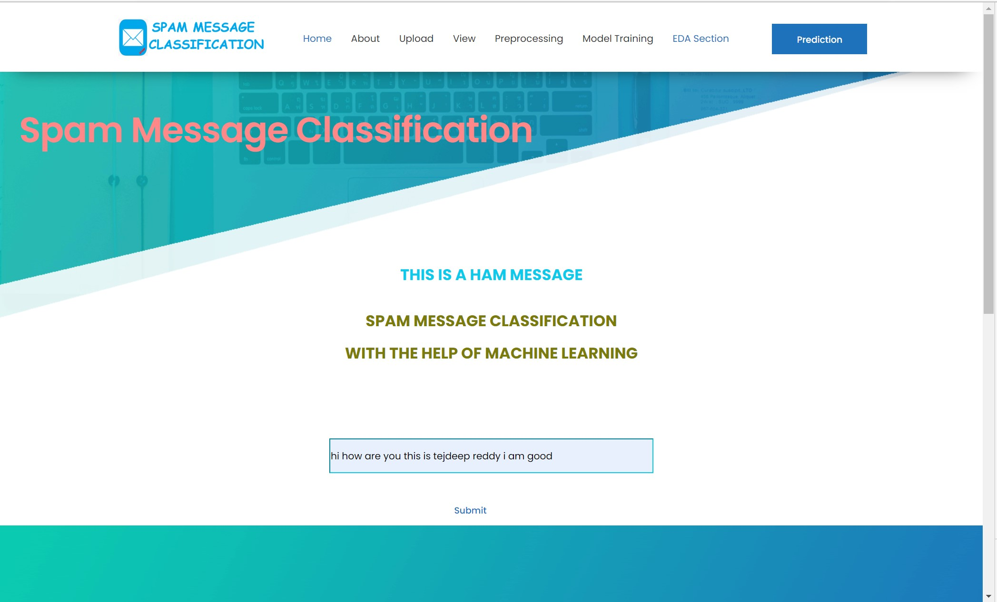
Contd...
@webapp.route('/prediction',methods=['POST','GET’])
def prediction():

Slide 26
Conclusion
In this , we proposed Spam Message Classification using two algorithms namely, Naïve Bayes and Support Vector Machine. By using this we can separate the spam and ham messages in the users data. It gives the accuracy rate of 98% with some variations in their decimal points.

Slide 27
References
[1] A. Tiago, Almeida , José María GómezAkebo Yamakami. Contributions to the Study of SMS Spam Filtering. University of Campinas, Sao Paulo, Brazil.
[2] Inwhee Joe and Hyetaek Shim, "An SMS Spam Filtering System Using Support Vector Machine," Division of Computer Science and Engineering, Hanyang University, Seoul, 133-791 South Korea.
[3] B. G. Becker. Visualizing Decision Table Classifiers. Pages 102- 105, IEEE (1998).

Slide 28
Thank You!!!

